Slide 1
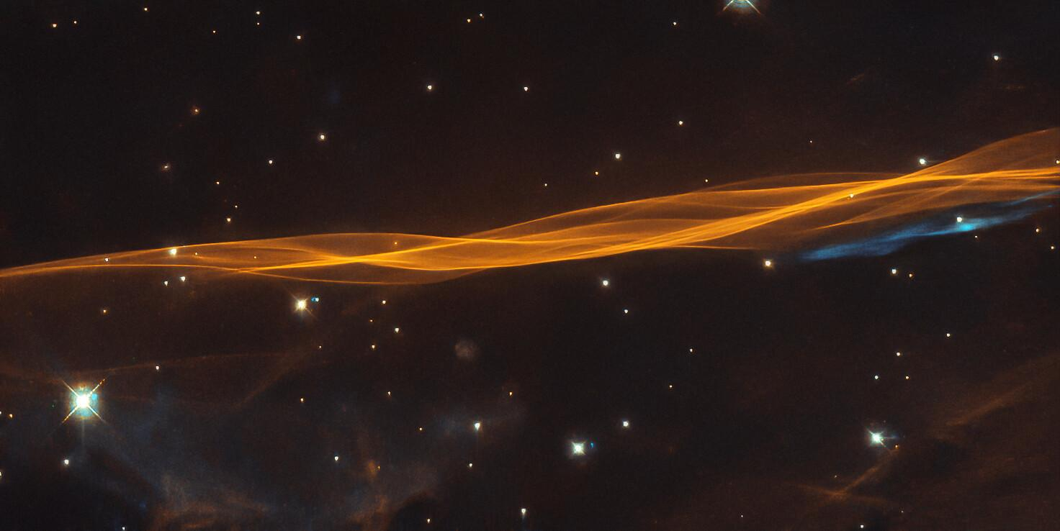
Stellar Classification Using Machine learning
Name : Abhinav Chaudhary
Contact : abhinav310199@gmail.com

Slide 2
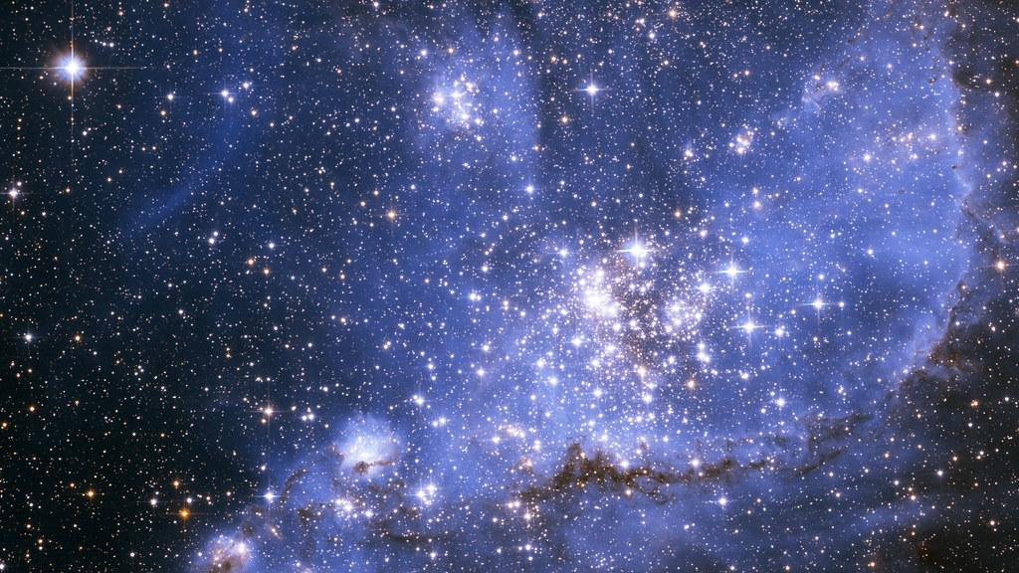
Motivation
The primary goal of the project is the classification of the stellar dataset. Stellar classification is the classification of stars based on spectral characteristics. The classification scheme of galaxies, stars, and quasars is one of the most fundamental in astronomy, this dataset aims to classify the above-mentioned class.

Slide 3
Data Set
1.obj_ID = Object Identifier, the unique value that identifies the object in the image catalog used by the CAS
2.alpha = Right Ascension angle (at J2000 epoch)
3.delta = Declination angle (at J2000 epoch)
4.u = Ultraviolet filter in the photometric system
5.g = Green filter in the photometric system
6.r = Red filter in the photometric system
7.i = Near Infrared filter in the photometric system
8.z = Infrared filter in the photometric system
9.run_ID = Run Number used to identify the specific scan
10.rereun_ID = Rerun Number to specify how the image was processed
11.cam_col = Camera column to identify the scanline within the run
12.field_ID = Field number to identify each field
13.spec_obj_ID = Unique ID used for optical spectroscopic objects (this means that 2 different observations with the same spec_obj_ID must share the output class)
14.class = object class (galaxy, star or quasar object)
15.redshift = redshift value based on the increase in wavelength
16.plate = plate ID, identifies each plate in SDSS
17.MJD = Modified Julian Date, used to indicate when a given piece of SDSS data was taken
18.fiber_ID = fiber ID that identifies the fiber that pointed the light at the focal plane in each observation

Slide 4
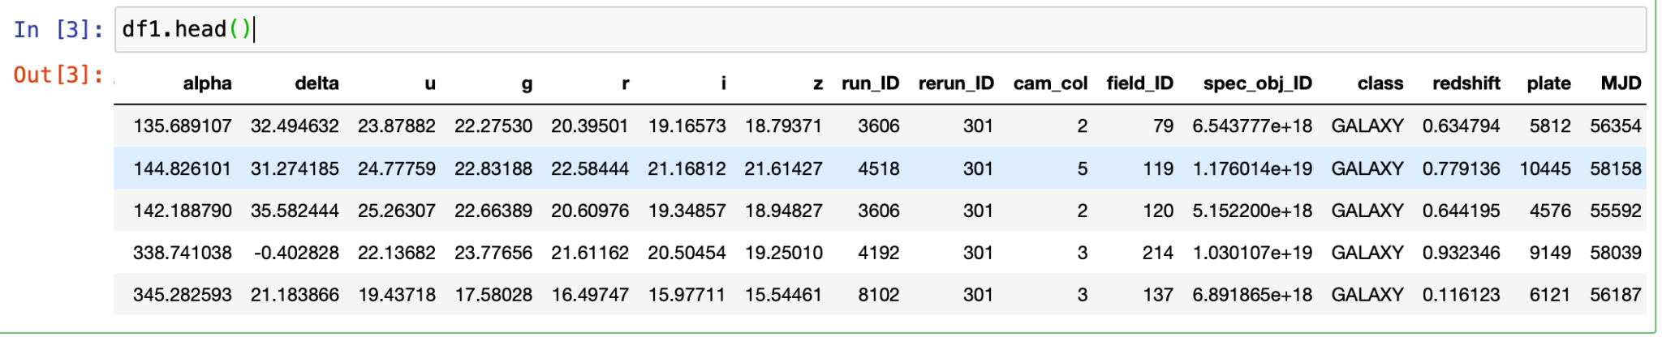
Sample Data set
df1.head()

Slide 5
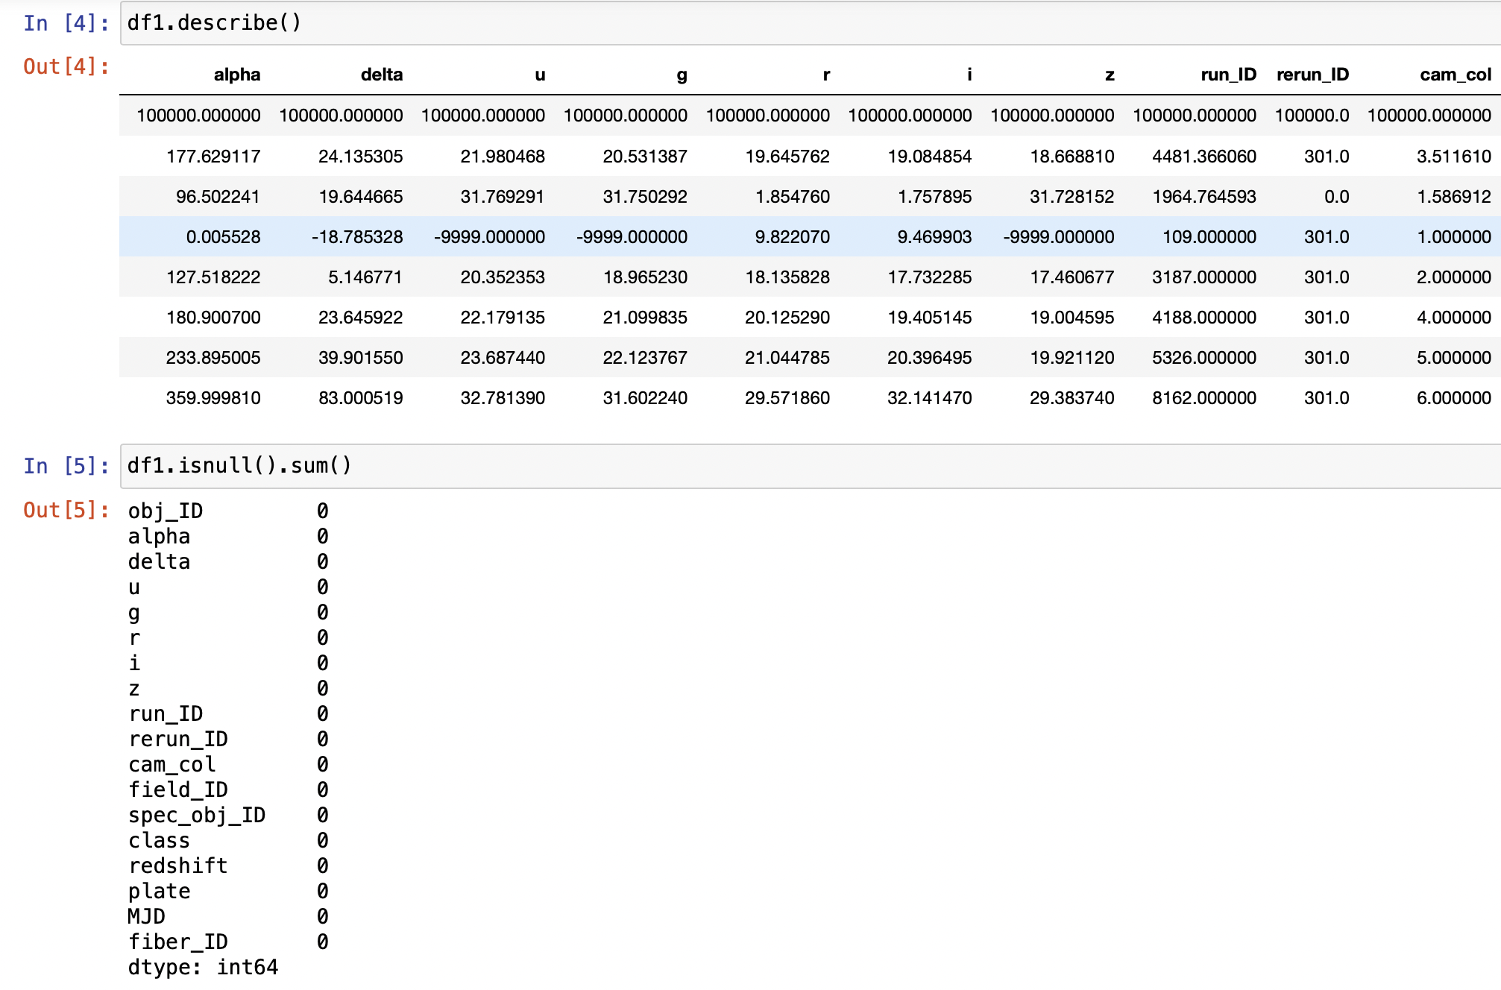
Exploratory Data analysis

Slide 6
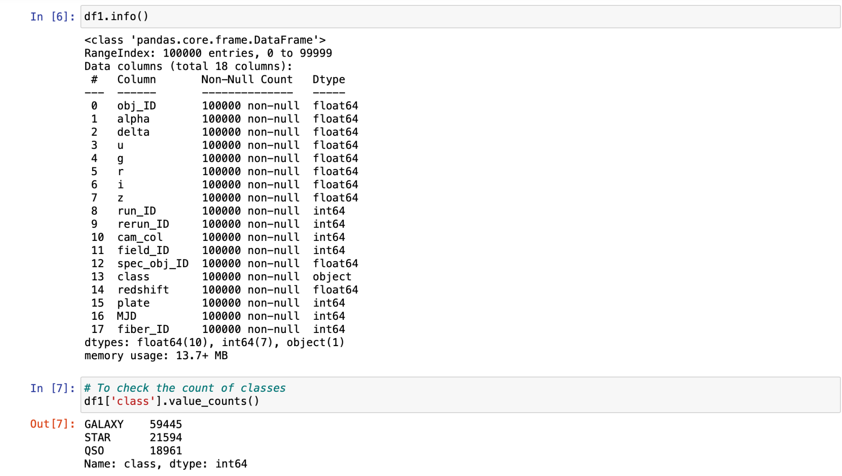

Slide 7
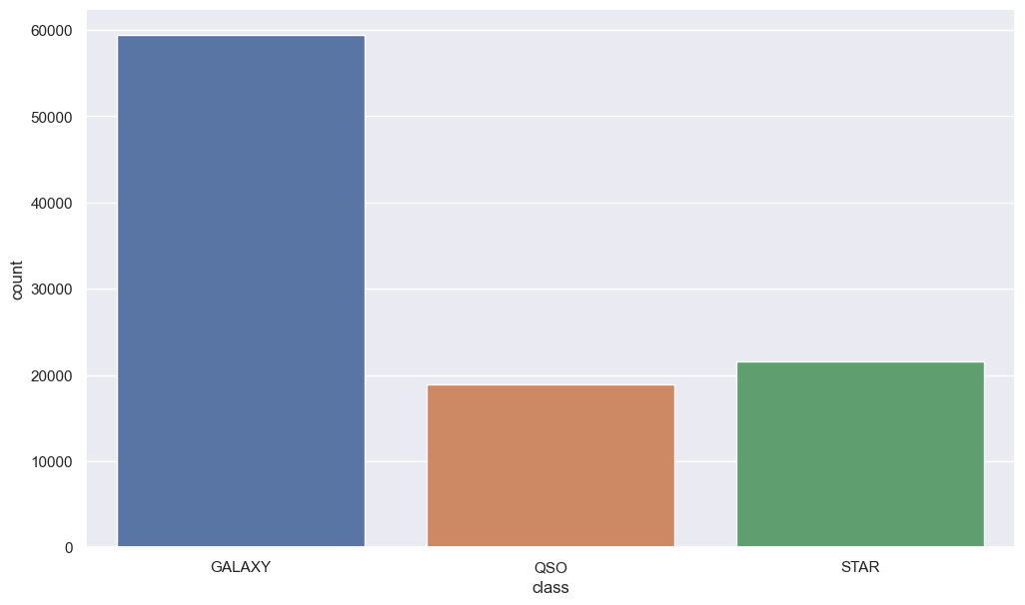
Distribution of Classes:

Slide 8
Check for correlation
• Initially we need to check for collinearity between the variables in the dataset which could lead to a 'Multicollinearity' problem.
•Multicollinearity tells a linear dependence between the independent variables. The existence of multicollinearity generates a high variance of the estimated coefficients and hence, the coefficient estimates corresponding to those interrelated independent variables will not be accurate in the classification model. They can become very sensitive to small changes in the model.
•Collinearity tells us how two variables are correlated with each other. In other words, if one variable is highly correlated with another, then most of the variance of one variable is explained by another (shares similar information). So, we may not include the highly correlated variable in the model. One way to extract correlation between variables is using Pearson's correlation coefficient.
•This correlation coefficient does not prove the 'Causality' (cause and effect). Causality tells the actual relation between variables unlike correlation which is just a possibility.

Slide 9
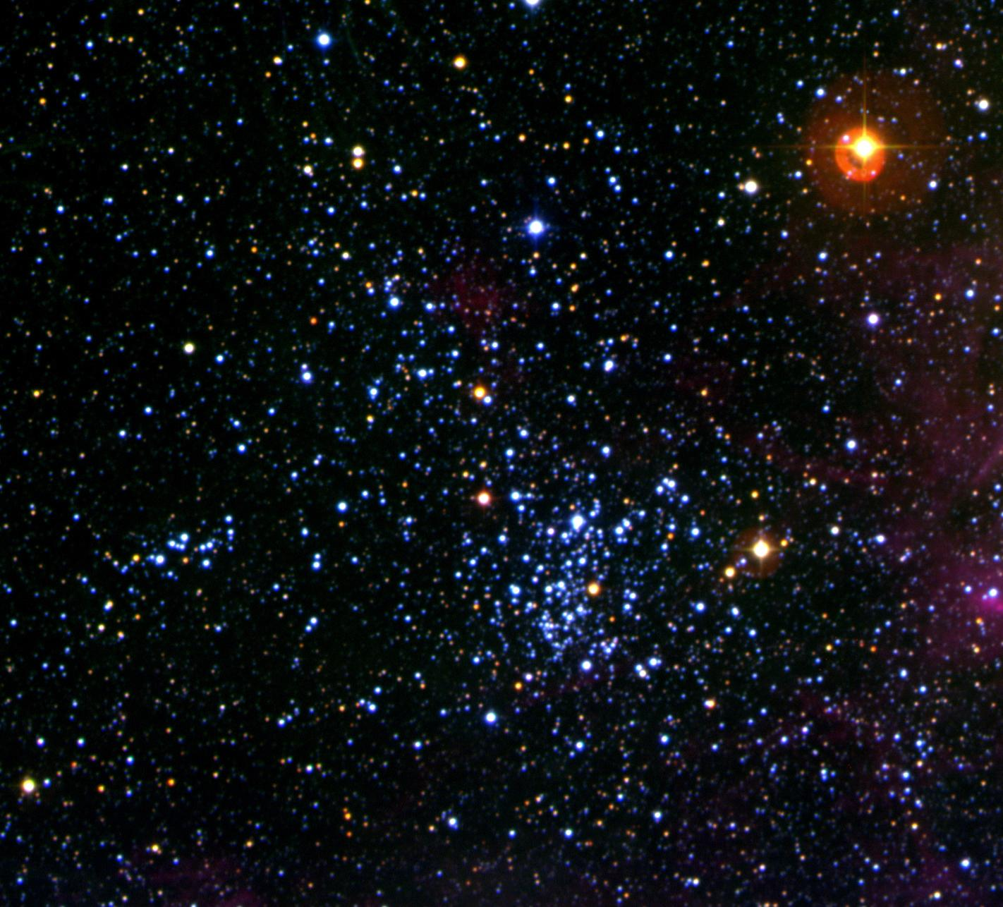
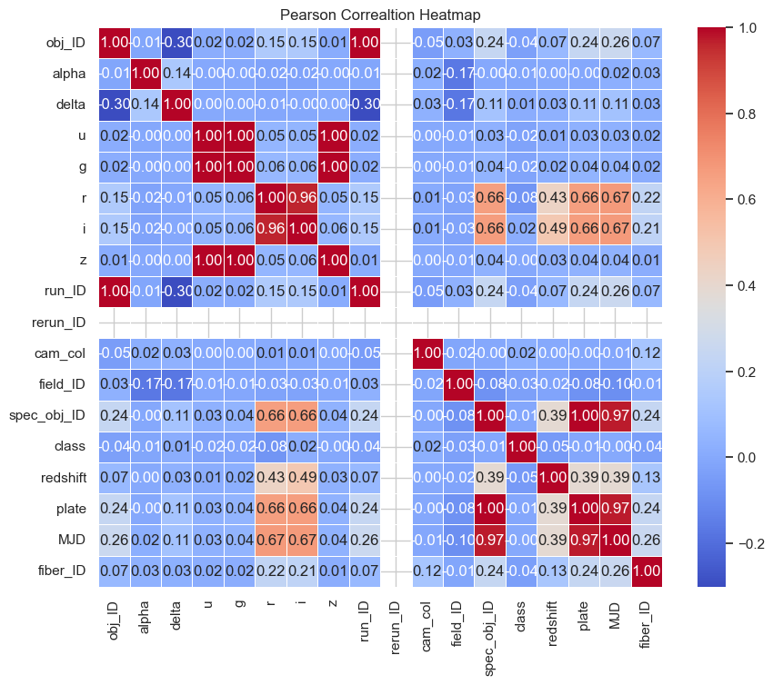
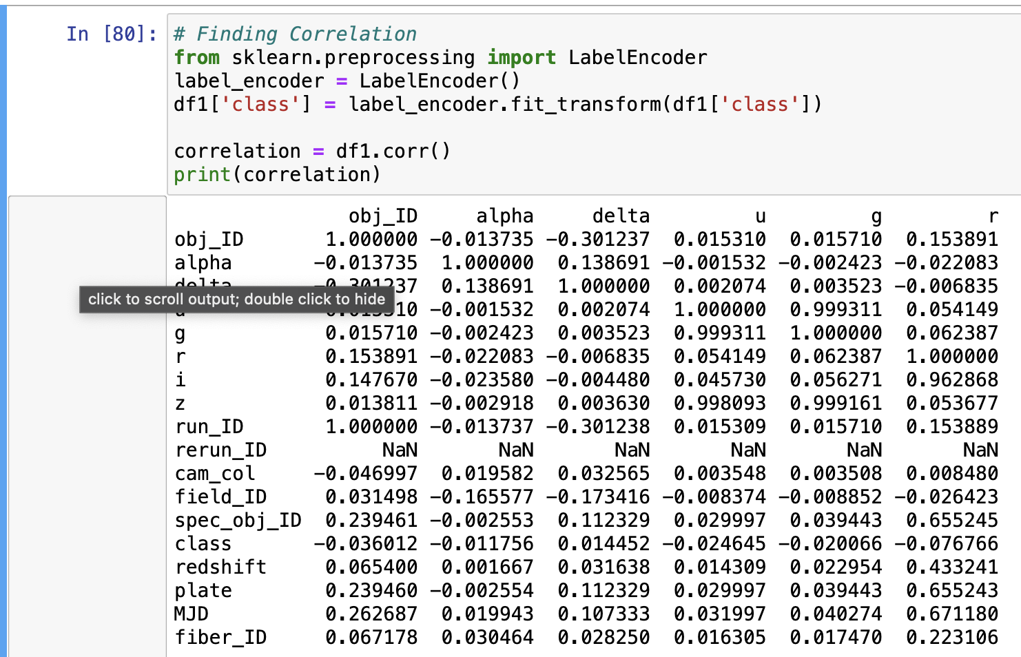
Correlation using heat map

Slide 10
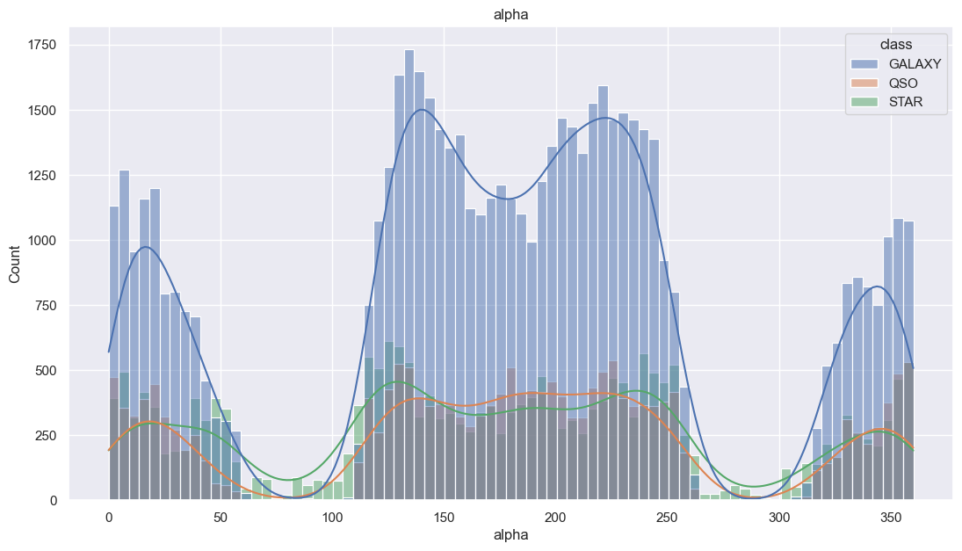
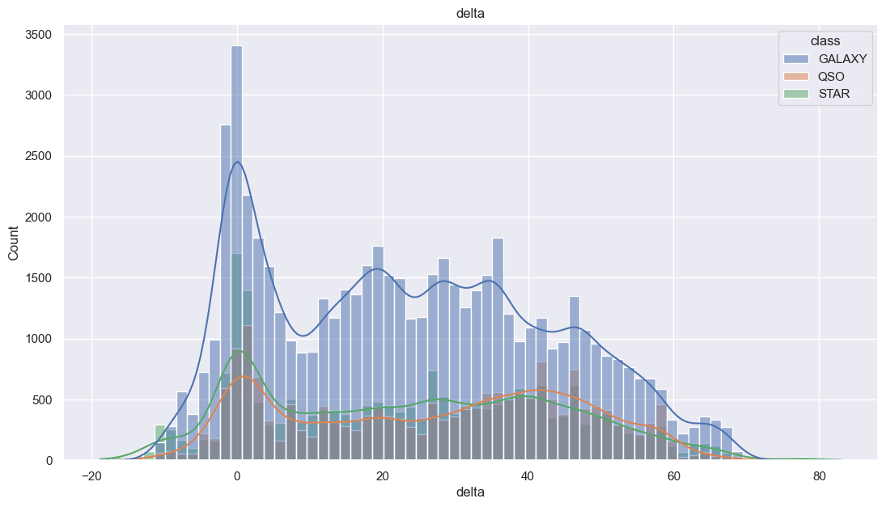
Feature Distribution Analysis:
As alpha, delta, u, g, r, i, z, redshift, plate, MJD are astronomical quantities, therefore, we'll keep them as our primary features.
Rest of the features are irrelevant or have no significant difference in distribution by class.

Slide 11
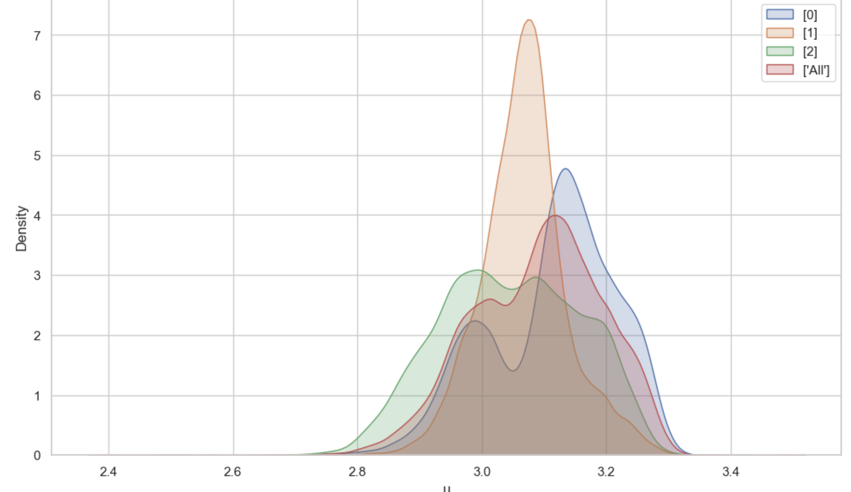
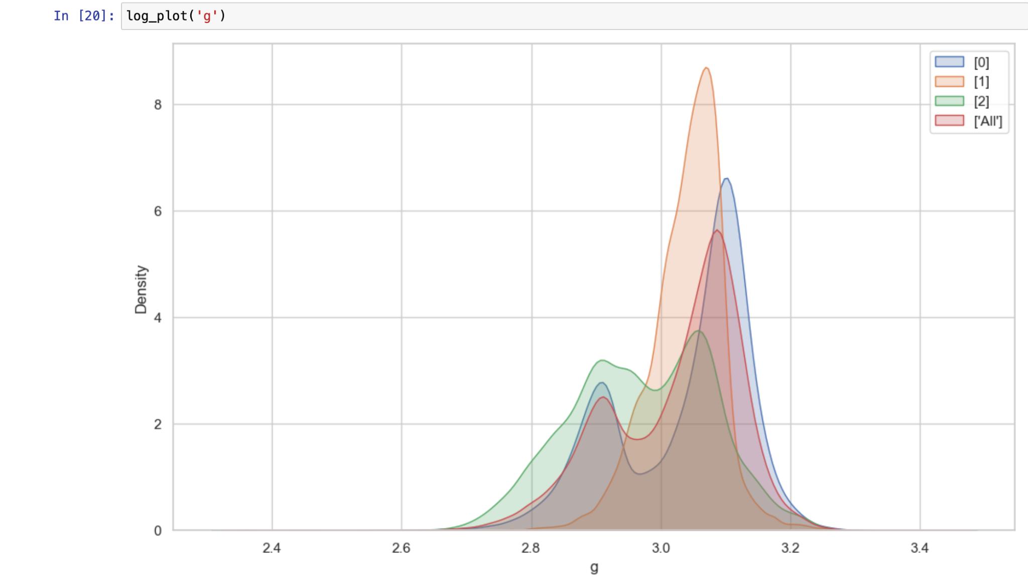
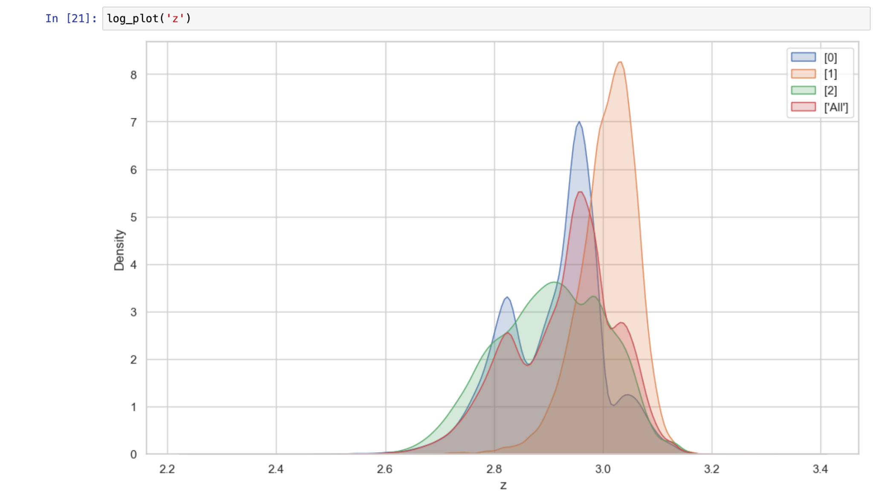
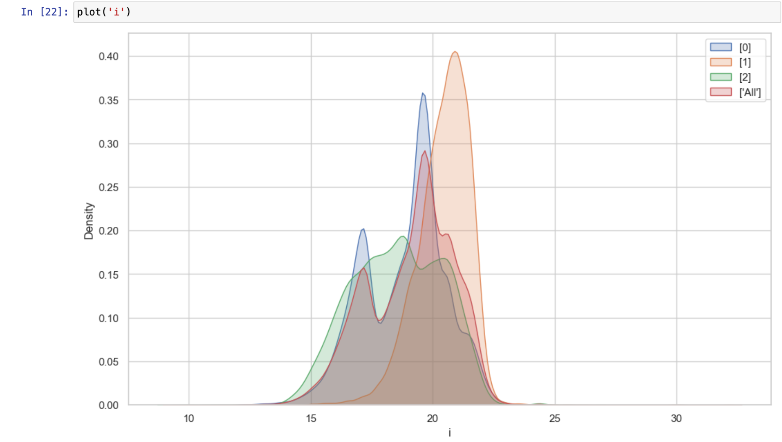
Plots for (‘log(u), log(g), log(z), i’)

Slide 12
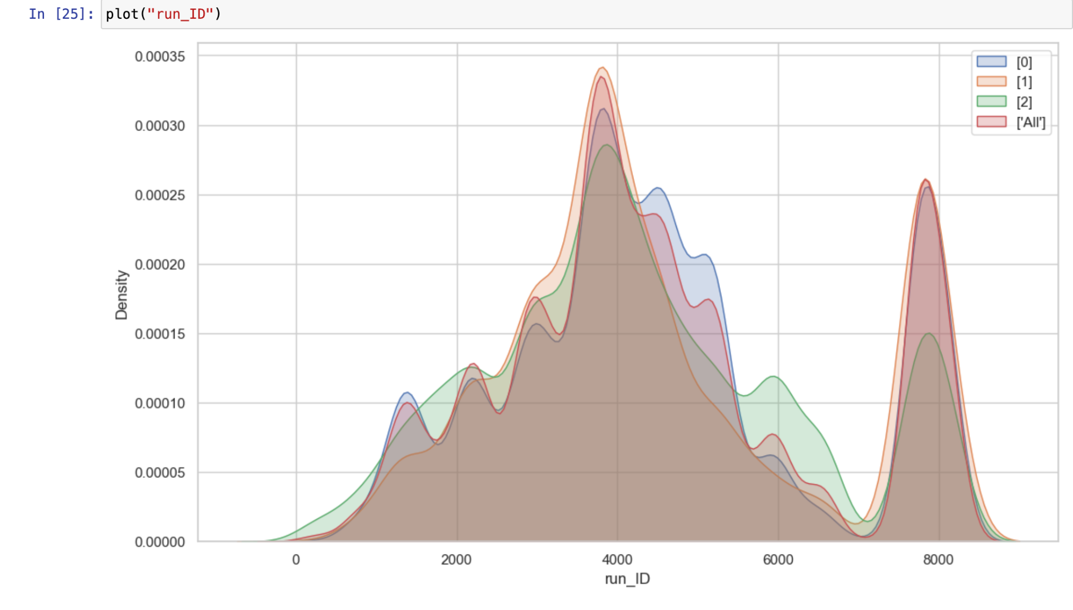
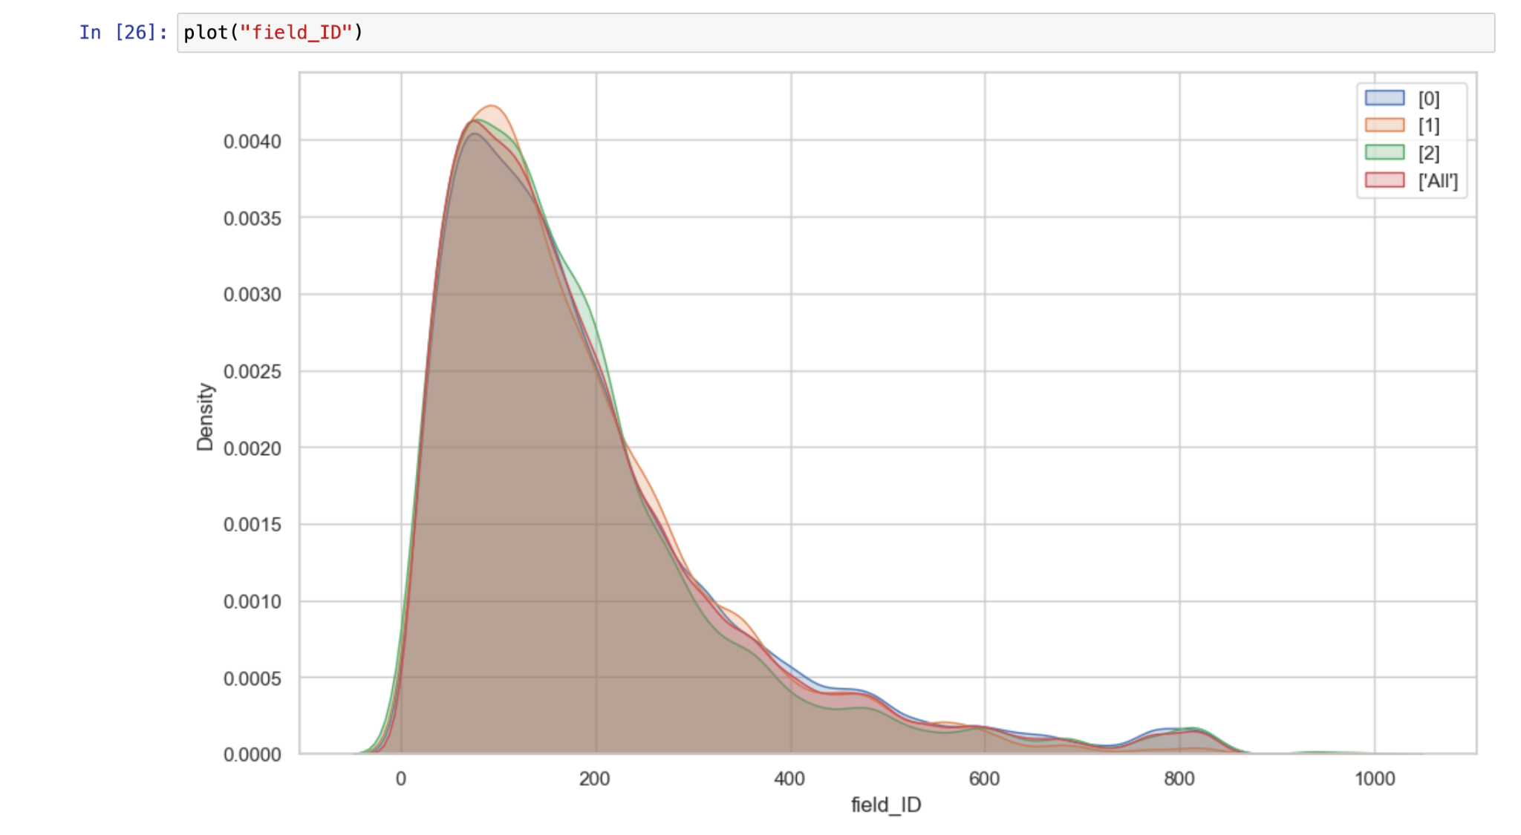
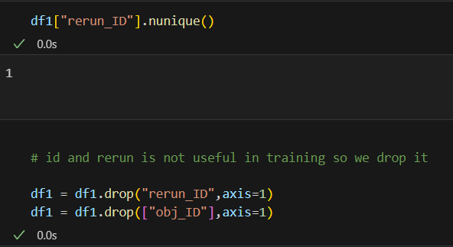
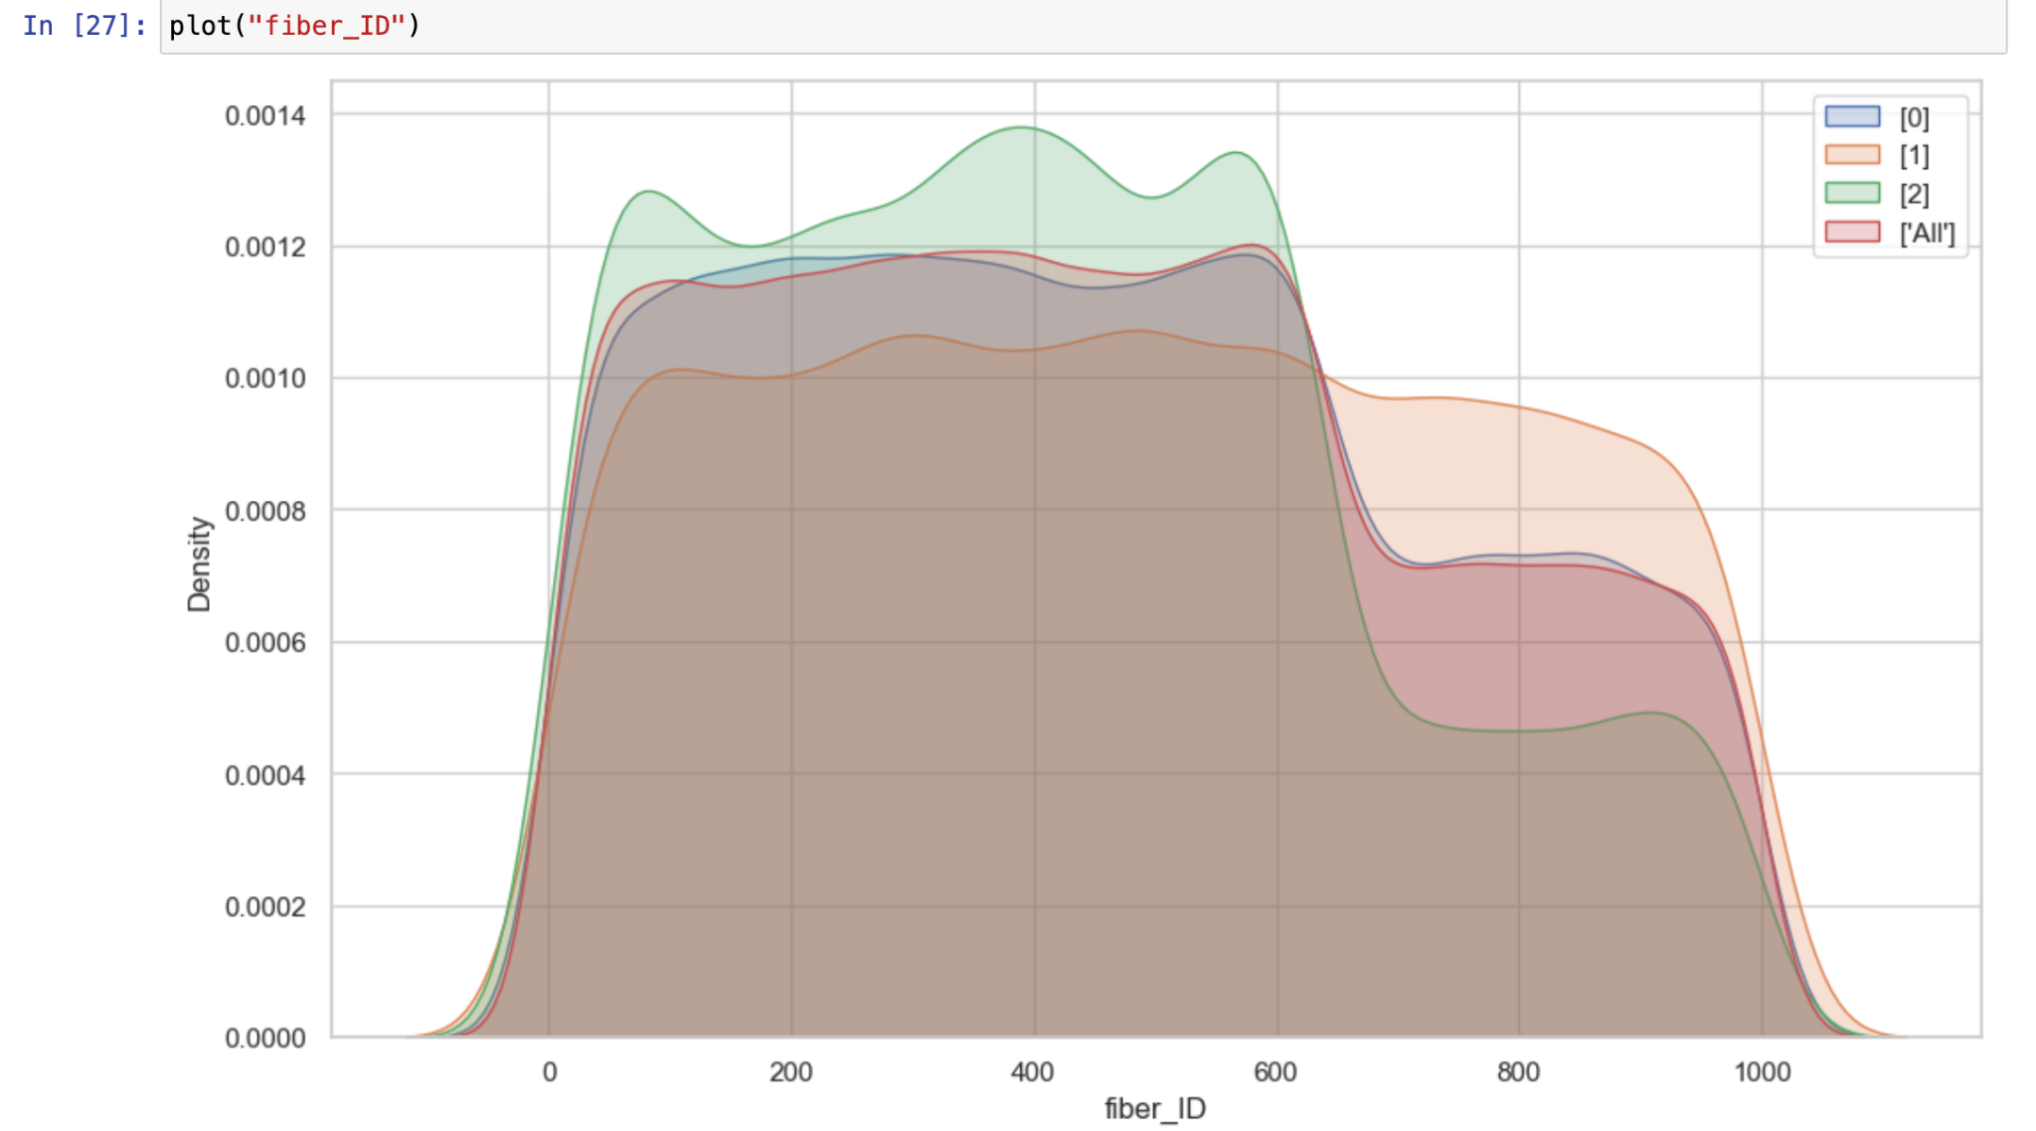
Plots for (run id, field id, fiber id)

Slide 13
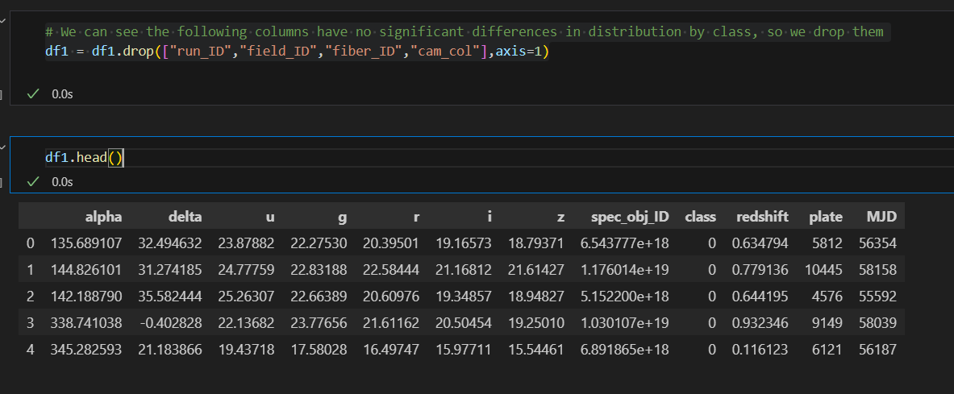
Final dataset:

Slide 14
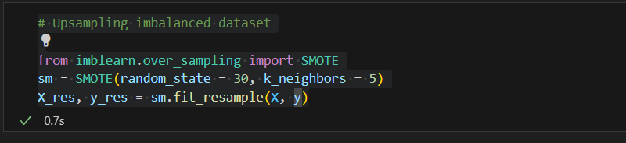
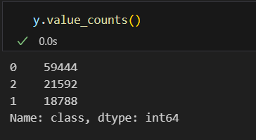
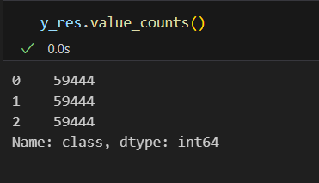
Upsampling classes:

Slide 15
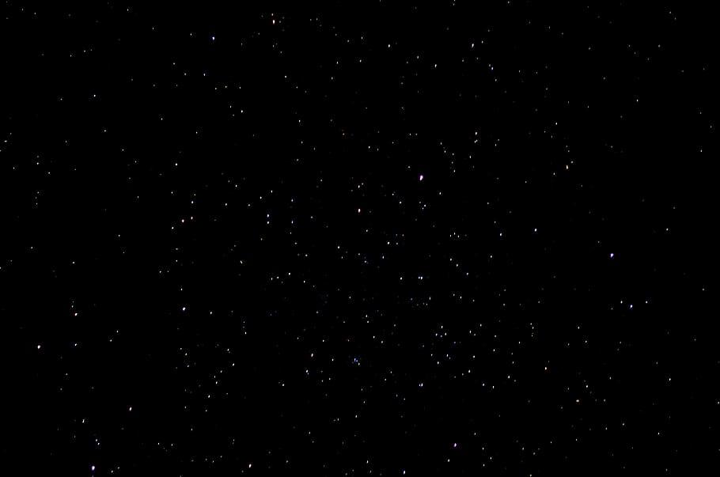
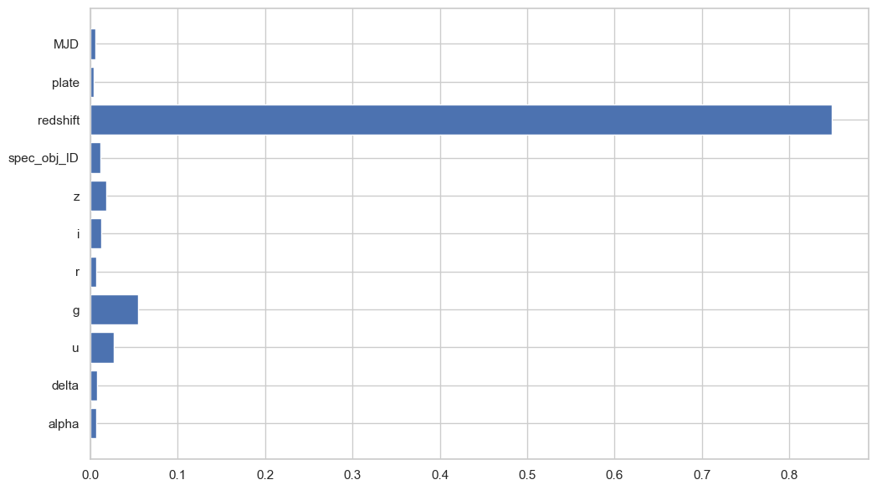
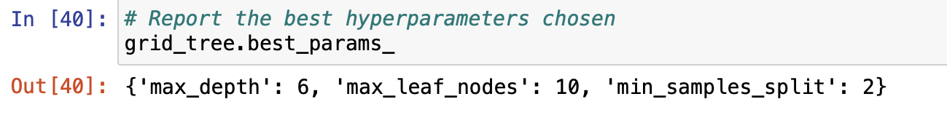
Decision Tree

Slide 16
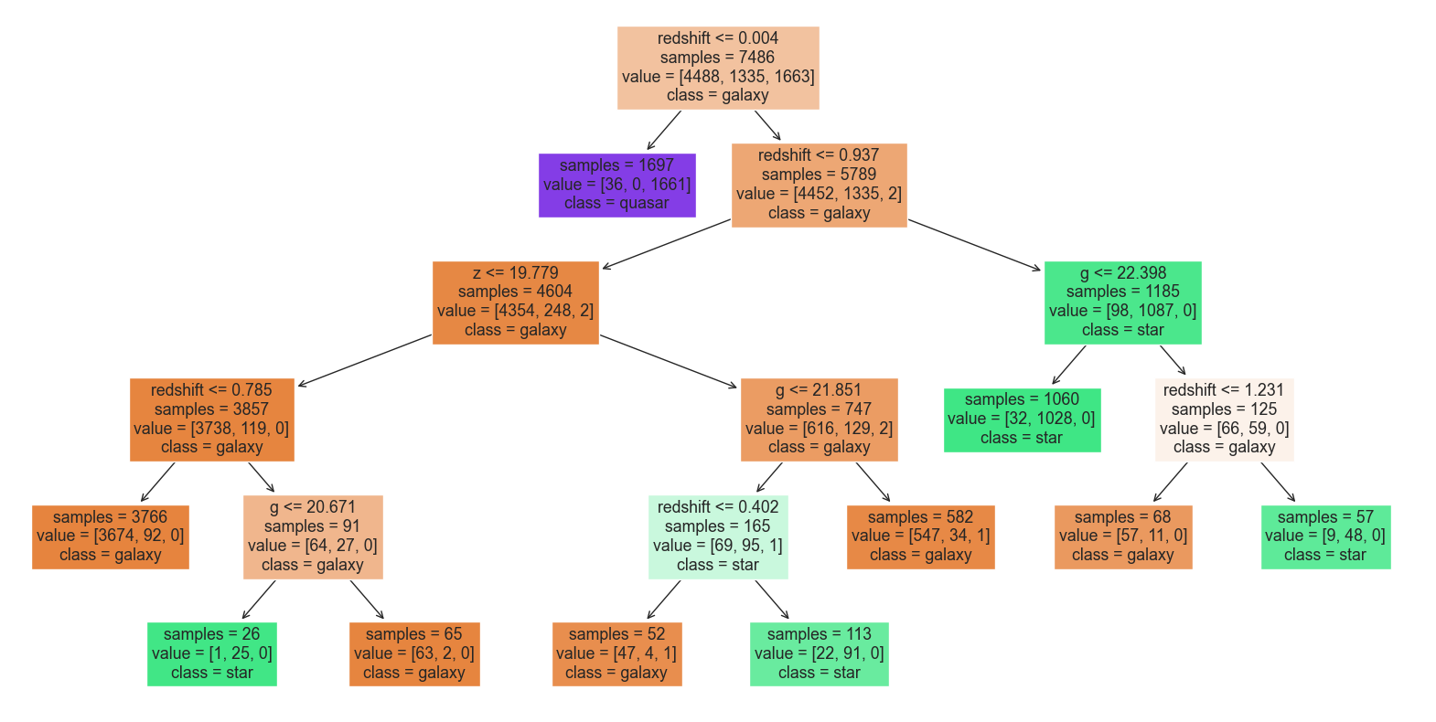

Slide 17
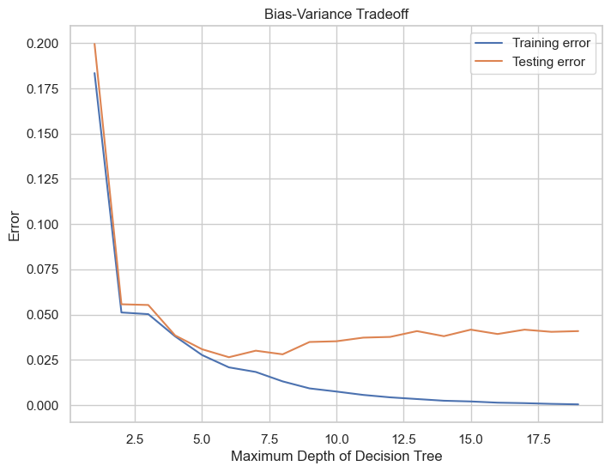

Slide 18
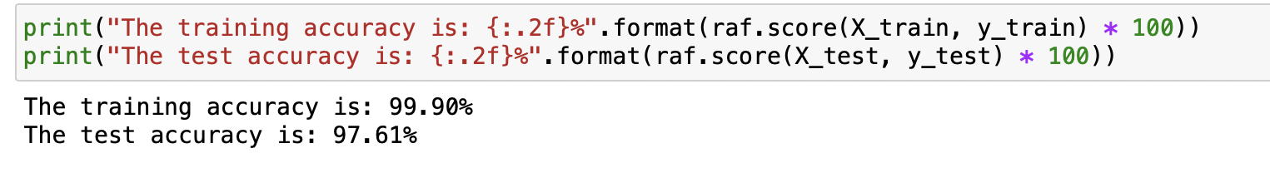
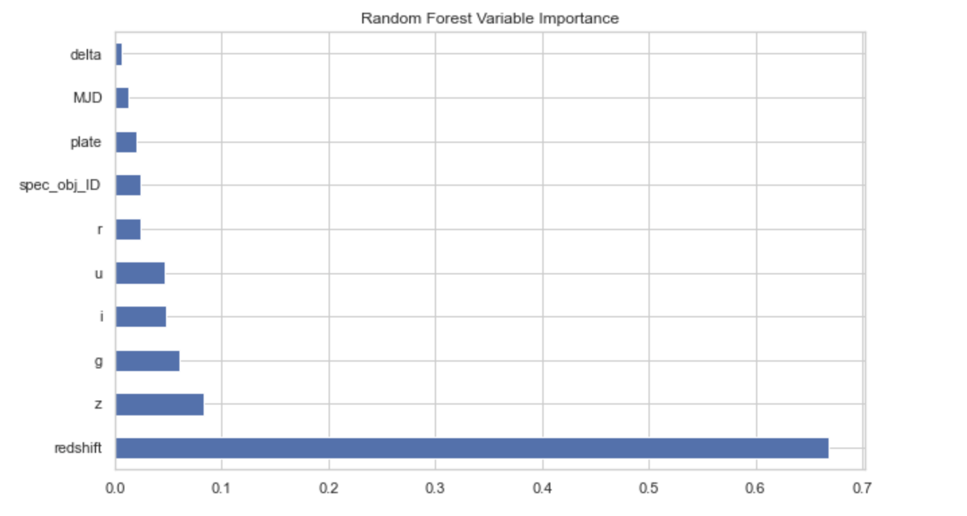
Random Forest

Slide 19
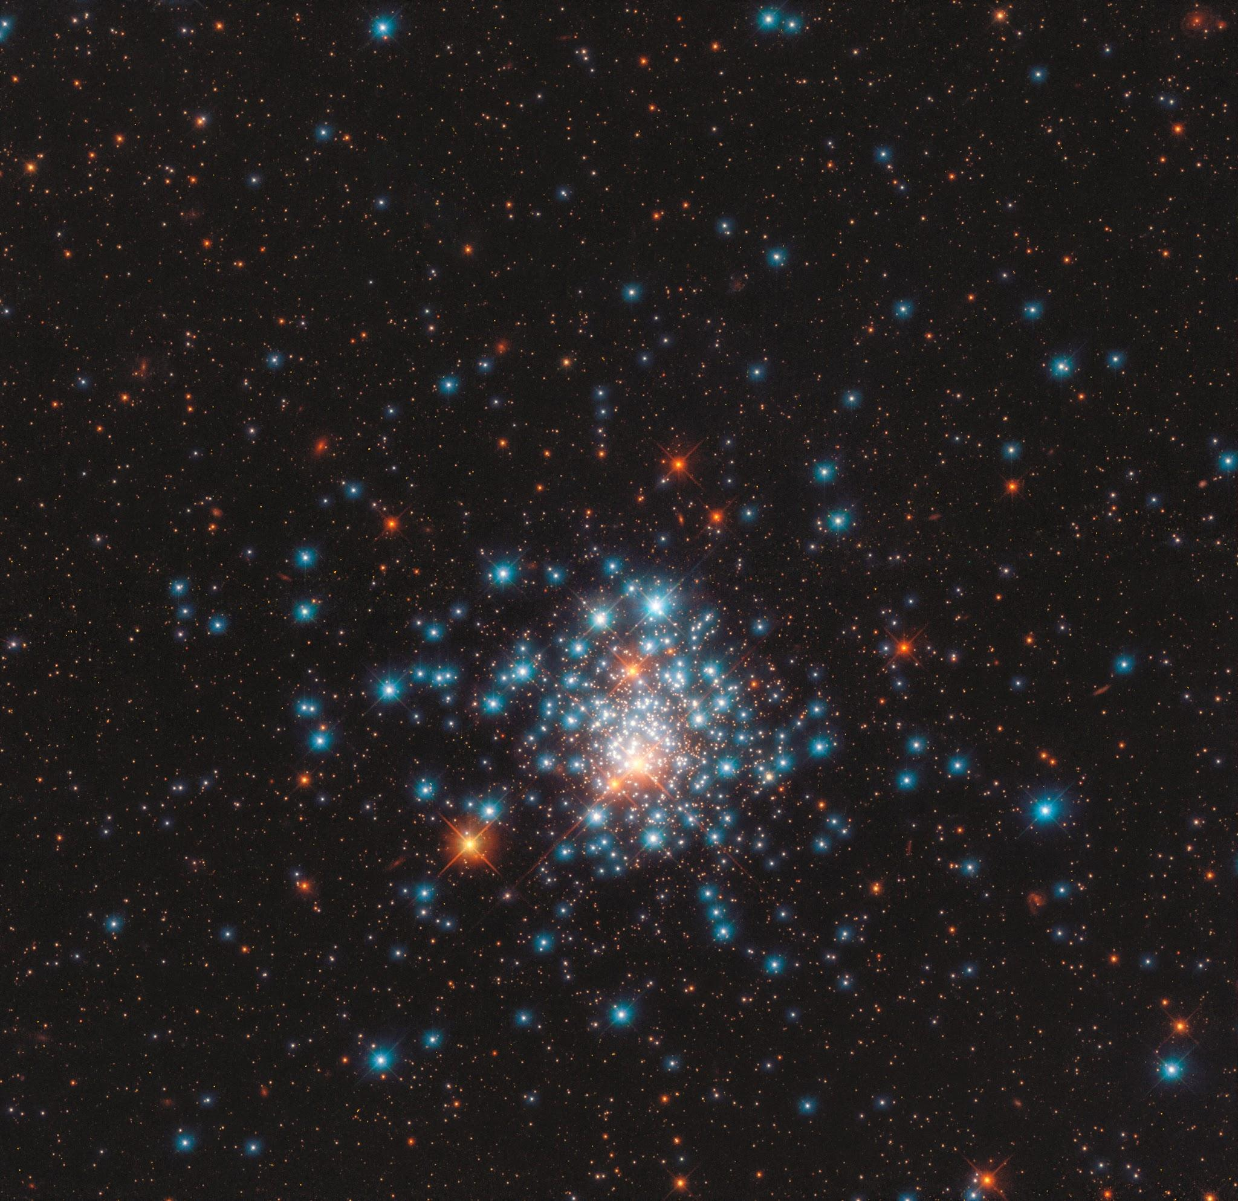
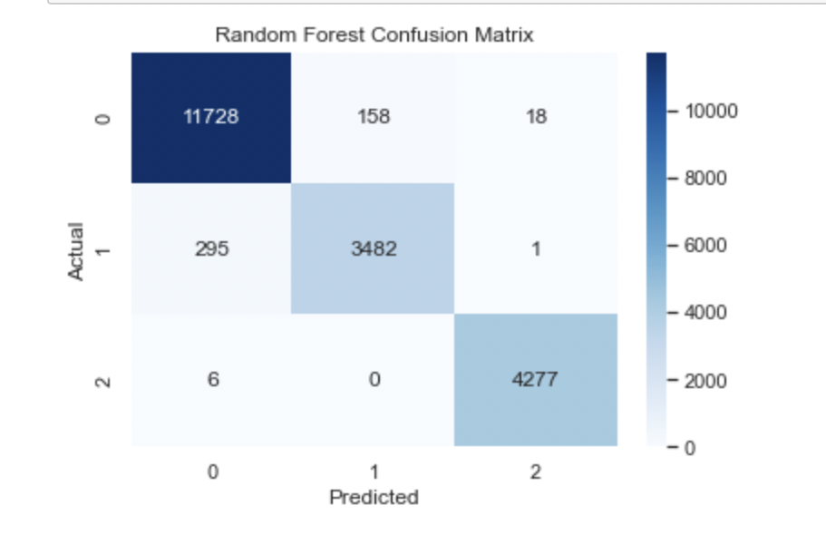

Slide 20
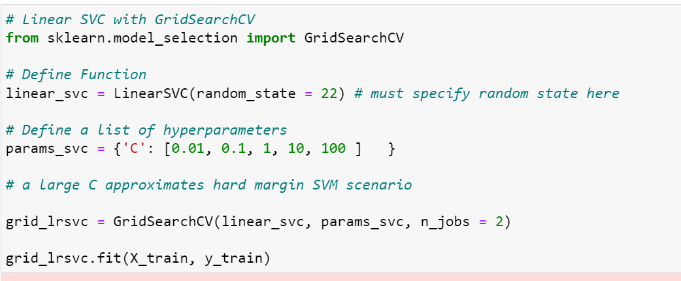

Slide 21
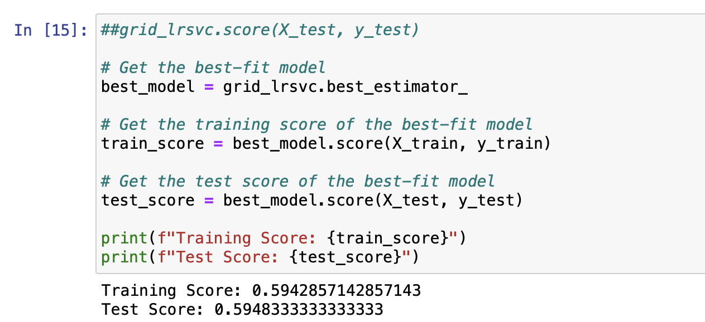
Support Vector Machine

Slide 22
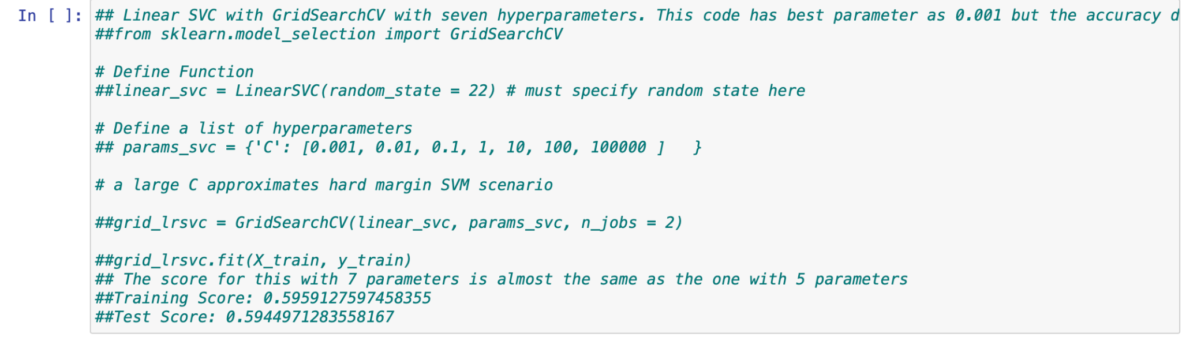
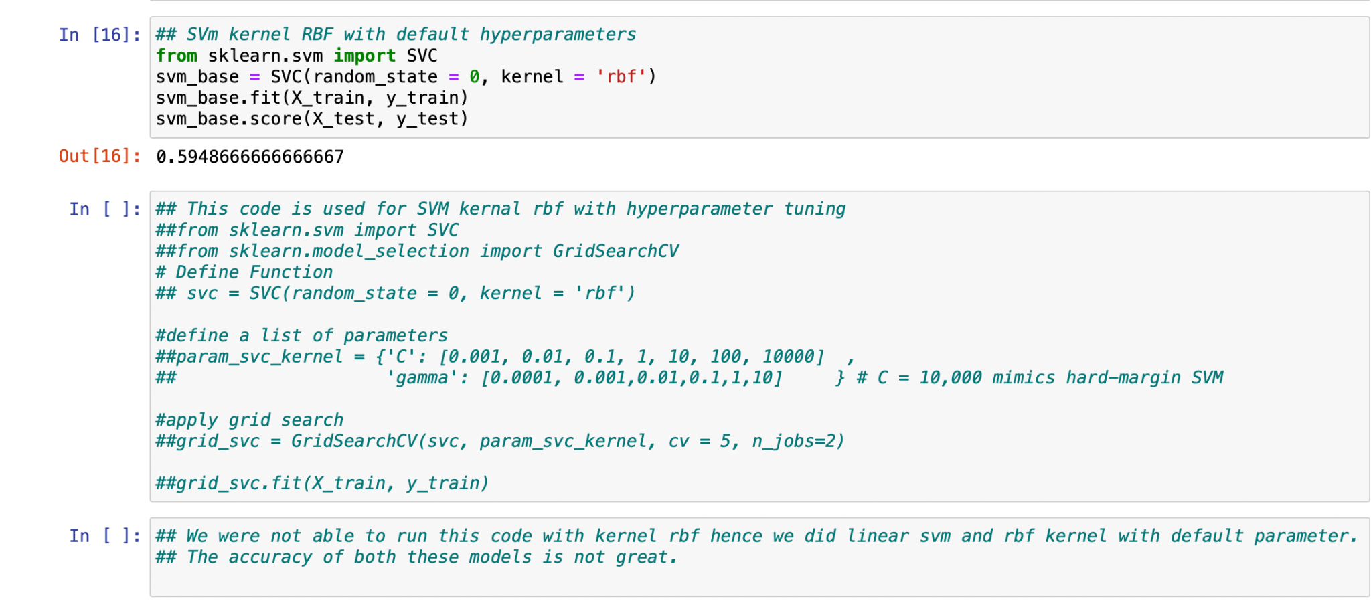

Slide 23
Conclusion
The Three models were fitted to the training data and evaluated using testing sample for a range of performance criteria.
When it comes to classifying stars, galaxies and quasars the random forest model developed in this project has a best accuracy, can be used as a competent and reliable classification tool.
Accuracy | Decision Tree | Random Forest | SVM
Training | 99.11 | 99.44 | 59.48
Testing | 96 | 97.61 | 59.42

